Slide 1
Learning Hash Functions Using Sparse Reconstruction
Yong Yuan, Xiaoqiang Lu, and Xuelong Li
Center for OPTical IMagery Analysis and Learning (OPTIMAL)
Notes:
Good morning,everyone, I'm Yong, Yuan, and I’m from Xi'an Institute of Optics and Precision Mechanics of Chinese Academy of Sciences. I’m very glade to share the work of Learning Hash Functions Using Sparse Reconstruction.

Slide 2

Roadmap
Overview
Method
Experiments
Summary
Notes:
Here is the main content of my presentation today. First let’s go to the overview.
2

Slide 3
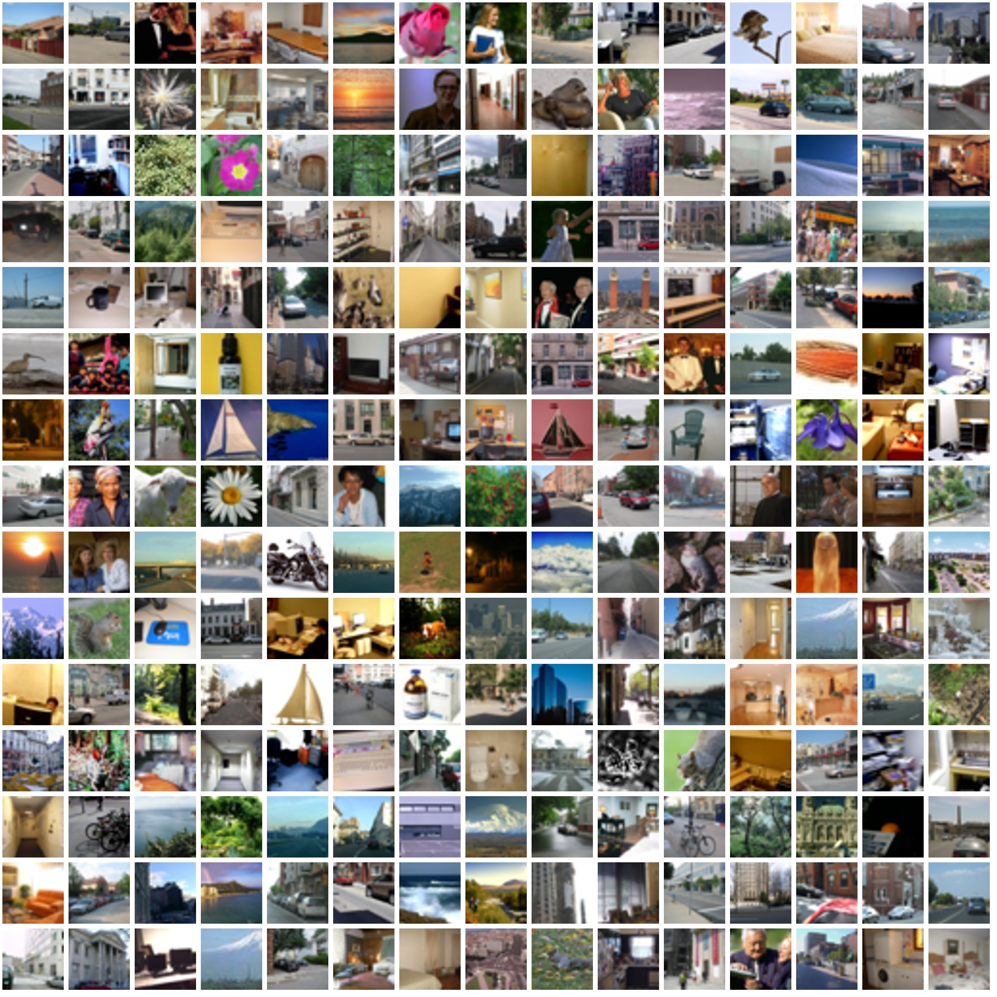





Near Neighbor Search
Notes:
In the field of information retrieval, one needs a reliable content-based similarity search engine.

Slide 4

Near Neighbor Search
Notes:
For example, the query picture contains a little boy.

Slide 5
Near Neighbor Search
Notes:
If we want to search the similar images in a small database, it’s efficient to use linear search.

Slide 6


Near Neighbor Search
Notes:
However, with the development of Internet and mobile digital devices,

Slide 7
Near Neighbor Search
Big data
Notes:
the database is bigger than the past, such the brute linear search not only wastes time but also requires large memory.

Slide 8
Near Neighbor Search
How do a content based image retrieval engine search a query efficiently?
Notes:
So how do a content based image retrieval engine search a query efficiently?

Slide 9



Similarity Preserving Binary Hashing
…
…
…
Notes:
To overcome these issues, many efforts have been devoted to investigating approximate nearest neighbor search such as tree-based methods, hashing-based methods.

Slide 10

Similarity Preserving Binary Hashing
…
…
…
…
…
…
110110
010110
001000
000001
Notes:
For the similar images, hash-based method tries to map them into the same or close hash buckets.

Slide 11
Similarity Preserving Binary Hashing
…
…
…
…
…
…
110110
010110
001000
000001
Hamming distance:
4
1
Notes:
That is, the hamming distance between similar images should be small.

Slide 12
Similarity Preserving Binary Hashing
…
…
…
…
…
…
110110
010110
001000
000001
Hamming distance:
4
1
Why binary codes?
— Query time is constant or sub-linear.
— Binary codes are storage-efficient.
Notes:
So why we need to use binary codes? There are two main reasons as follows: first, query time is constant or sub-linear. Second, binary codes are storage-efficient.

Slide 13


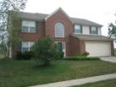














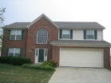

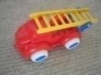
Hashing Using Compact Codes
Dataset
Notes:
The process of hash methods to image retrieval can be described as follows: For the images in the database,

Slide 14




Hashing Using Compact Codes
Dataset
000101
110111
100001
Simple hash table
Notes:
The hash functions H(.) can encode all the images in the database into binary codes.

Slide 15
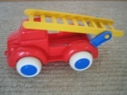
Hashing Using Compact Codes
Dataset
110111
000101
110111
Q
XOR
100001
Simple hash table
Notes:
Given a query image, the hash functions H(.) also encode it into binary code. Then calculates the hamming distance using XOR operator. One can rank them to get the candidates.

Slide 16
Hashing Using Compact Codes
Dataset
Search the hash table
for a small set of images.
<< N
Q
110111
000101
110111
Q
XOR
100001
Simple hash table
Notes:
If one needs a more accurate result, we can re rank them by Euclidean distance since the candidates size is smaller than the database.

Slide 17
Hashing Using Compact Codes
Dataset
Search the hash table
for a small set of images.
Key point:
<< N
Q
110111
000101
110111
Q
XOR
100001
Simple hash table
Notes:
From the encoding process, we can see the hash functions H(.) is the key point.

Slide 18
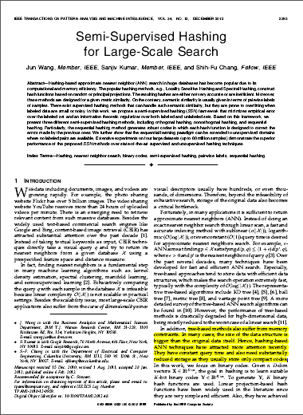
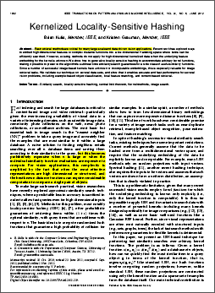
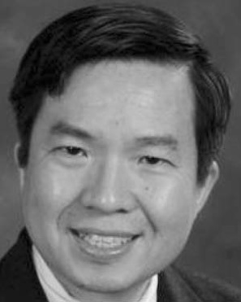
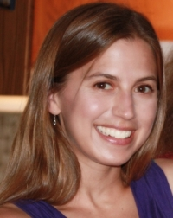
Two of the Representative
The director of DMVV, Shih-Fu Chang: They have constant query time and also need sub-stantially reduced storage as they usually store only compact codes. TPAMI, 2012.
The leader of UT-ACVG, Kristen Grauman, To make large-scale search practical, vision researchers have recently explored approxi-mate similarity search techniques. TPAMI, 2012.
Notes:
To construct efficient hash functions, many researchers have devoted great efforts, such as the director of DMVV, Shih-Fu Chang, the leader of UT-ACVG, Kristen Grauman.

Slide 19
Roadmap
Overview
Method
Experiments
Summary
Notes:
section two gives the detail of our method.
19

Slide 20
Motivations
Projection | Learning paradigm | Method | Year
Data-independent | Unsupervised | LSH | 1999
 |  | SIKH | 2009(NIPS)
Data-dependent | Unsupervised | SH | 2008(NIPS)
 |  | CH | 2011(ICCV)
 |  | ITQ | 2012(TPAMI)
 |  | KMH | 2013(CVPR)
 |  | KRH | 2014(CVPR)
 | Semi-supervised | S3PLH | 2010(ICML)
 |  | SSH | 2012(TPAMI)
 |  | BSPLH | 2012(TKDE)
 | Supervised | BSSC | 2006
 |  | BRE | 2009(NIPS)
 |  | KSH | 2012(CVPR)
A limitation of most hash based methods to explore the sparse reconstructive relationship of the data constructing hash functions. (Motivation A)
Notes:
Here we list some classic and latest hash methods according to the projection category and the learning paradigm. Though most state-of-the-art works have achieved great performance, a limitation of them to explore the sparse reconstructive relationship of the data.

Slide 21
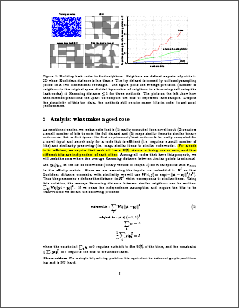
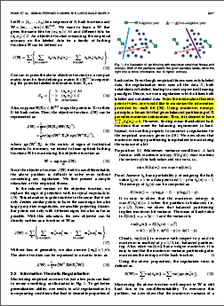
Motivations
If a sparse reconstruction is adopted, to maximize the information provided by each bit, how to incorporate this requirement with reconstruction
simultaneously? (Motivation B)
Using maximum entropy
principle, a binary bit that gives balanced partitioning of X provides maximum information. TPAMI, 2012.
Does a balance between them improve the performance?
For a code to be eﬃcient, we require that each bit has a 50% chance of being one or zero, and that diﬀerent bits are independent of each other.
NIPS, 2008.
How to build the balance?
Notes:
Besides, as shown in spectral hashing, for a code to be efficient, each bit require a 50% chance of being or zero, this has been demonstrated to satisfy the maximum entropy in semi-supervised hashing. (动画)
If a sparse reconstruction is adopted, to maximize the information provided by each bit, how to incorporate this requirement with reconstruction?
And does a balance between them improve the performance? How do we build the balance?
With these motivations and the questions, we propose the following method
21

Slide 22
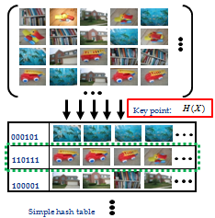
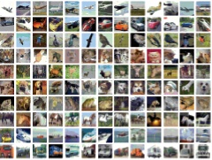
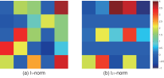
Framework of Our Method
Flow chart of the proposed method to learn hash functions.
Step 1
General consensus
& entropy regularizer.
Step 2
Sparse reconstruction using L-2,1 norm. (Motivation A)
Step 3
Build a balance between them. (Motivation B)
Adjusted covariance matrix.
Sparse reconstructiion
Cifar-10 dataset
Paradigm A
Paradigm B
Notes:
The proposed method can be summarized into three step, Here we show the Framework of our method. As described above, the key of hash method is how to construct efficient hash functions. The flow chart shows the main idea of our method, we divide the hash functions’ construction into three steps. First, General consensus and entropy regularizer, second, Sparse reconstruction using L-two-one, third, build a balance between them. The following part we will show them step by step.

Slide 23
Step 1:
Hash Function:
Notes:
Step one:
The hash function is set as this formulation:

Slide 24
Step 1:
Hash Function:
0
,
Notes:
After zero-centering the data points, the threshold is zero. Then the hash function can be rewritten as a simple sign function.

Slide 25






























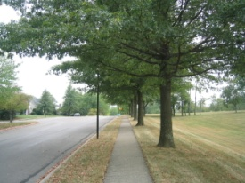
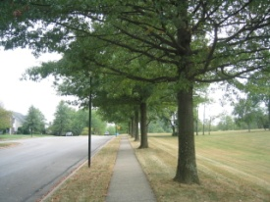
Step 1:
Hash Function:
0
,
General consensus & entropy regularizer
General consensus
Encode them into the same bucket.
Notes:
There is a general consensus that for a pair of images xi and xj , if xi and xj are similar to each other, it's important for hash functions to encourage them to be encoded into similar binary codes.

Slide 26
Step 1:
Hash Function:
0
,
General consensus & entropy regularizer
General consensus
Encode them into the same bucket.
Notes:
Based on the general consensus, we can get the J-zero formulation.

Slide 27
Step 1:
Hash Function:
0
,
General consensus & entropy regularizer
General consensus
Reflect the similarity of two hash codes.
Encode them into the same bucket.
Notes:
The inner product reflects the similarity of two hash codes.

Slide 28
Step 1:
Hash Function:
0
,
General consensus & entropy regularizer
General consensus
Weight element denoted the same in complementary hashing.
Encode them into the same bucket.
Notes:
Tij is a weight between xi and xj, which is denoted the same as sij in complementary hashing.

Slide 29
Step 1:
Hash Function:
0
,
General consensus & entropy regularizer
General consensus
Relaxing the
signed magnitude.
Encode them into the same bucket.
Notes:
After relaxing the signed magnitude, J-zero can be rewritten as the trace form.

Slide 30
Step 1:
Hash Function:
0
,
General consensus & entropy regularizer
Each bit requires a 50% chance of being one or zero.
Notes:
For a code to be eﬃcient, Each bit requires a 50% chance of being one or zero.

Slide 31
Step 1:
Hash Function:
0
,
General consensus & entropy regularizer
Each bit requires a 50% chance of being one or zero.
Notes:
To satisfy this requirement, one can getting the formulation.

Slide 32
Step 1:
Hash Function:
0
,
General consensus & entropy regularizer
Each bit requires a 50% chance of being one or zero.
Maximize the variance of hash functions.
Entropy regularizer [1].
[1]. J. Wang, O. Kumar, and S.F. Chang, “Semi-supervised hashing for scalable image retrieval,”
Proc. IEEE Conf. Computer Vision and Pattern Recognition, pp. 3424-3431, 2010.
Notes:
The formulation can be rewritten as maximize the variance of hash functions according to information theory's maximum entropy rule. This work have been demonstrated in semi-supervised hashing.

Slide 33
Step 1:
Hash Function:
0
,
General consensus & entropy regularizer
Each bit requires a 50% chance of being one or zero.
Maximize the variance of hash functions.
Combining the general consensus and the entropy regularizer.
Notes:
By combining the general consensus and the entropy regularizer, the formulation can be written as J-one.

Slide 34
Step 2:
Sparsity preserving projections (SPP)
Notes:
Then, I’ll show the step two:
We use SPP to capture discriminate information since sparse representation has natural discriminate power. Besides, we also insert the graph Laplacian structure to SPP to preserve the manifold structure.

Slide 35
Step 2:
Sparsity preserving projections (SPP)
Notes:
The functions can be rewritten as this formulation.

Slide 36
Step 2:
Sparsity preserving projections (SPP)
M is the graph Laplacian matrix.
Notes:
M is the graph Laplacian matrix

Slide 37

Step 2:
Sparsity preserving projections (SPP)
Notes:
The Fig. shows the l-two-one-norm has a structured sparse attribute compared with l-one-norm.

Slide 38
Step 2:
Sparsity preserving projections (SPP)
,
Notes:
The formulation can be simplified as J-two,

Slide 39
Step 3:
Final objective function:
Incorporates to build a balance between the maximum of empirical accuracy combined with the information theory, manifold structure and the minimum of sparse reconstruction of data points.
Notes:
By considering the formulation J-two and J-one, the final objective function is presented as this. The objective formulation incorporates to build a balance between the maximum of empirical accuracy combined with the information theoretic, manifold structure and the minimum of sparse reconstruction of data points.

Slide 40
Optimization
Step 1: Fix and update :
Generalized eigenvalue decomposition problem.
Step 2: Fix and update :
Take derivation with respect of .
Notes:
The solution of proposed objective formulation can be divided into two alternating steps:
First, Fix S and update W, J can be rewritten as J(W). The minimization problem can be solved by generalized eigenvalue decomposition problem.
Second, Fix W and update S, J can be rewritten as J(S). This can be solved by taking with respect of S.
This can be solve by taking derivation with respect of S

Slide 41
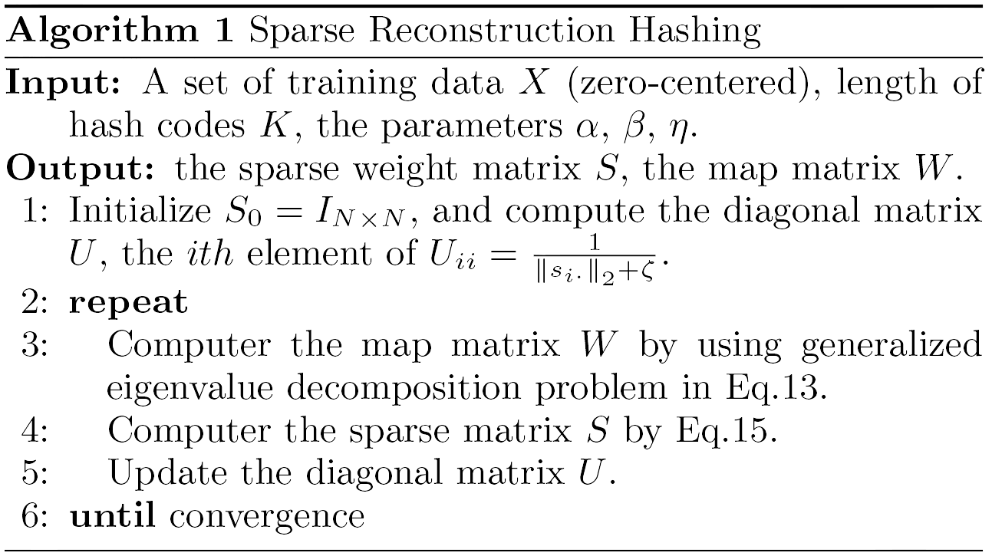
Algorithm
Notes:
The Algorithm can be summarized as follows, more details can be seen in the paper. In the experiments, we notice that matrix S in indeed sparse. And after we get the matrix W, the corresponding relationship between W and hash functions H can be shown as the following:

Slide 42
Encode Binary Codes
…
…
…
，
，
，
…
…
…
110110
010110
001000
000001
Notes:
Here shows the relation between them. Notice K is the code length. Since the threshold is set to zero, It’s very important to centering the whole dataset.

Slide 43
Roadmap
Overview
Method
Experiments
Summary
Notes:
After introducing our method, experimental results will be shown in this part to demonstrate the effectiveness.
43

Slide 44
Experiments
Datasets:
— Cifar-10 Dataset : 60k*320d Gist.
— Tiny100k Dataset : 100K*384d Gist.
Evaluation protocol:
— For each query, find all points within a certain hamming radius or
find M nearest neighbors by exhaustive hamming ranking.
Settings:
— Cifar-10 data1K for test
Unsupervised: 59k for training (database), 1K for query.
— Tiny100k images data
Unsupervised: 96k for training (database), 4K for query.
— Parameter selection
Alpha: 0.5, beta: 0.1.
Notes:
To evaluate our method, We use two datasets. One is Cifar-ten, the other is Tiny one hundred thousand thousand, all of them are very popular to evaluate the effectiveness of hash methods. For Cifar-ten, we extract three hundred twenty dimension gist feature, the Tiny one hundred thousand, we use 384 dimension gist feature.
For the evaluation protocol, we find M nearest neighbors by exhaustive hamming ranking to evaluate our method.
The settings are as follows: for cifar-ten, 59 thousand for training. One thousand for query. For Tiny100k, 4 thousand for query.
In the final objective formulation, there are two parameters. In our experiments, alpha and beta are set as zero point five and zero point one, repectively.

Slide 45
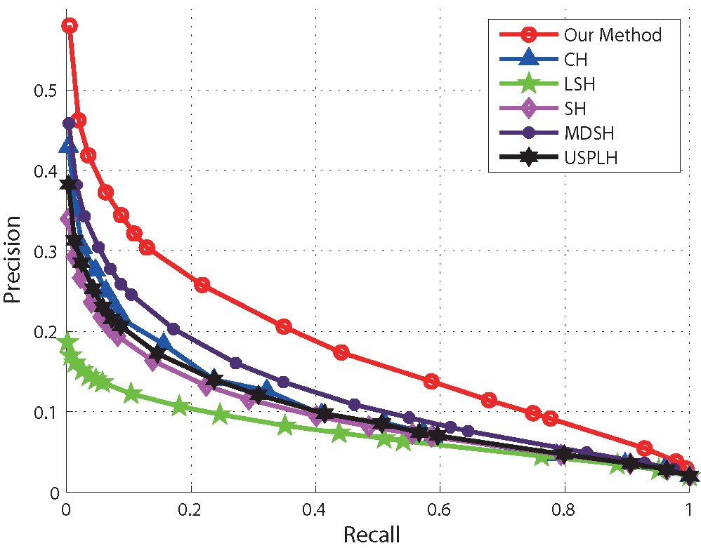
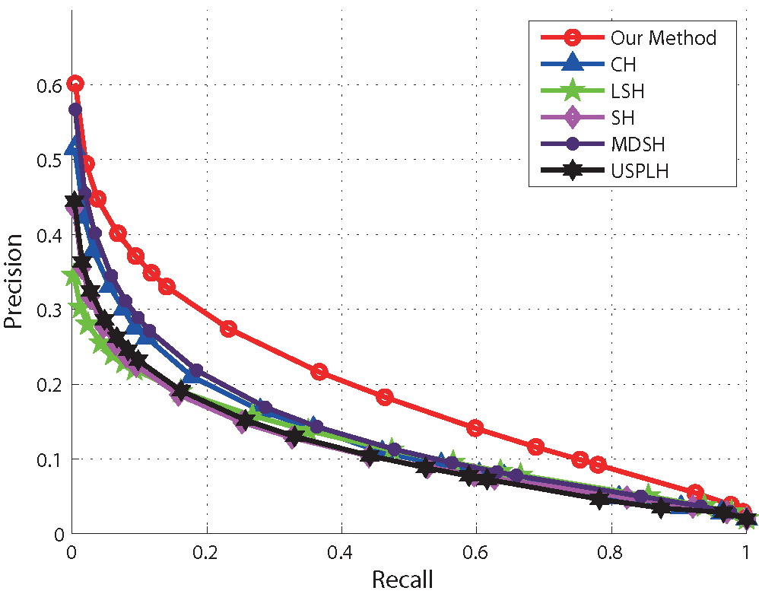
Experiments
Cifar-10 precision recall curve
16 bits
32 bits
Notes:
We choose Complementary hashing，Local Sensitive Hashing, Spectral Hashing，Multidimensional spectral hashing，unsupervised sequential projection learning hashing to compare with our method. All of them are unsupervised and neglect the sparse structure. The codes of them are available to the authors’ homepage. The precision recall curves shows that when the encoding length is 16 bits and 32 bits, our method outperforms the others.

Slide 46
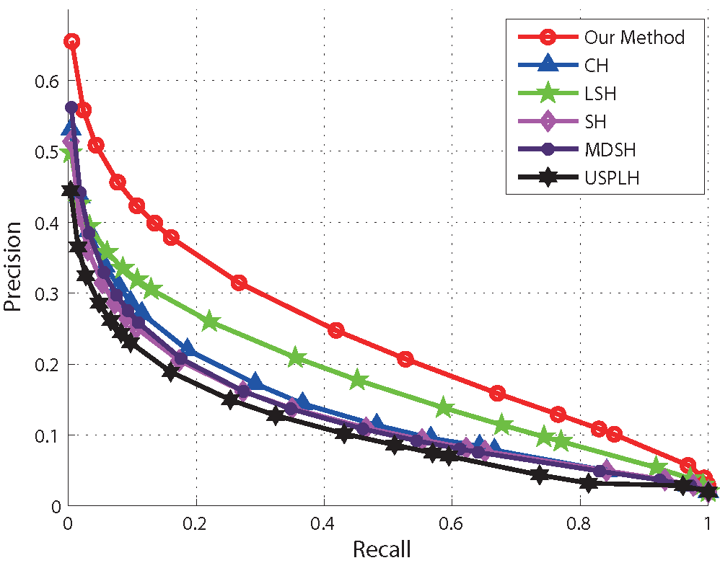
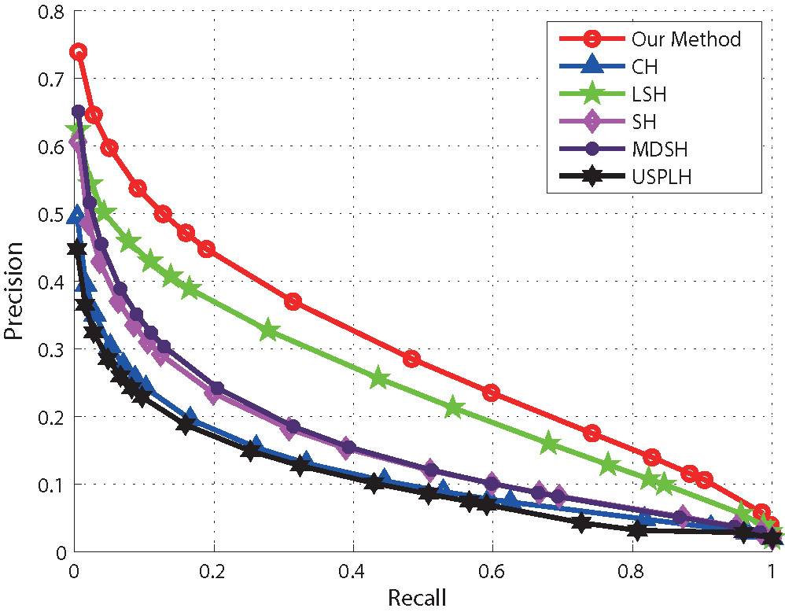
Experiments
Cifar-10 precision recall curve
64 bits
128 bits
Notes:
So does 64 bits and 128 bits. As we can see, it clearly observed that for the precision recall curve, all of the methods obtain larger areas when the encoding length increases. Besides, our method achieves better performance than the others for various encoding length.

Slide 47
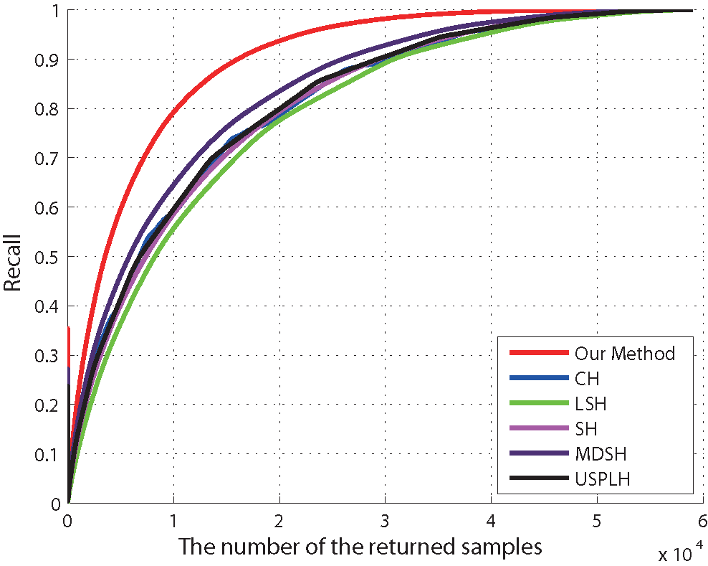
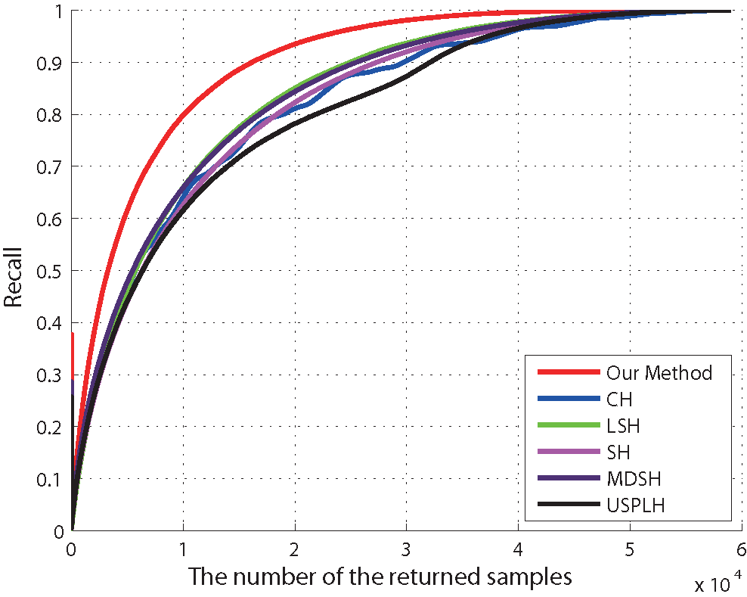
Experiments
Cifar-10 recall-the number of return samples curve
16 bits
32 bits
24 bits
Notes:
We also use the recall-the number of return samples curve to evaluate the recall rate of our method compared with the others, as we can see clearly, for the fixed number of the returned samples, the recall rate is higher than others.

Slide 48
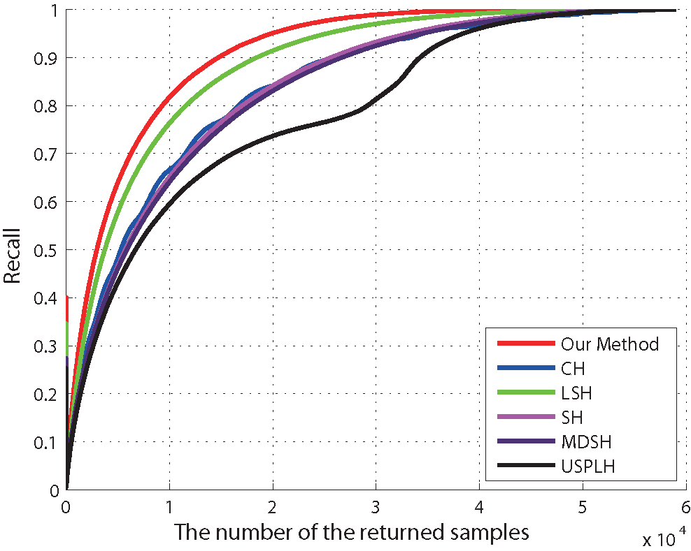
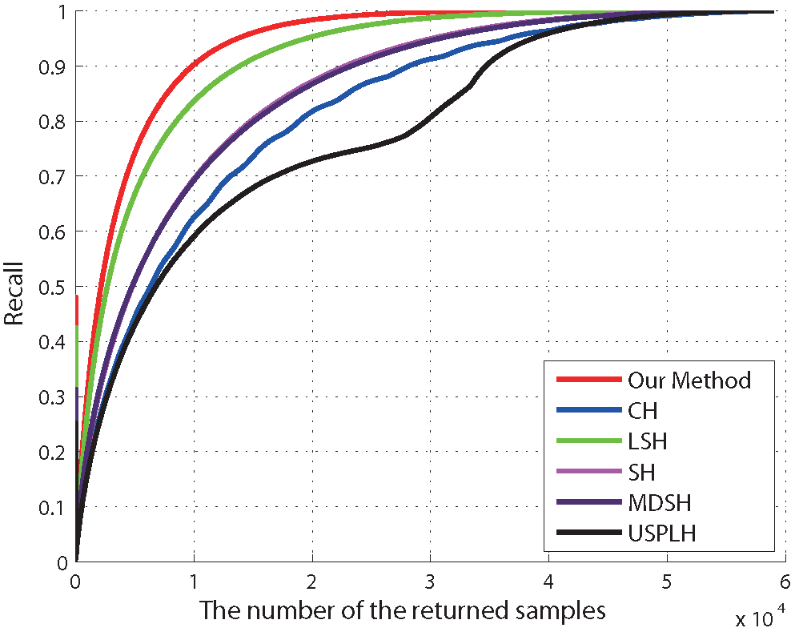
Experiments
Cifar-10 recall-the number of return samples curve
64 bit
128 bit
128 bit
Notes:
So does 64 bits and 128 bits.

Slide 49
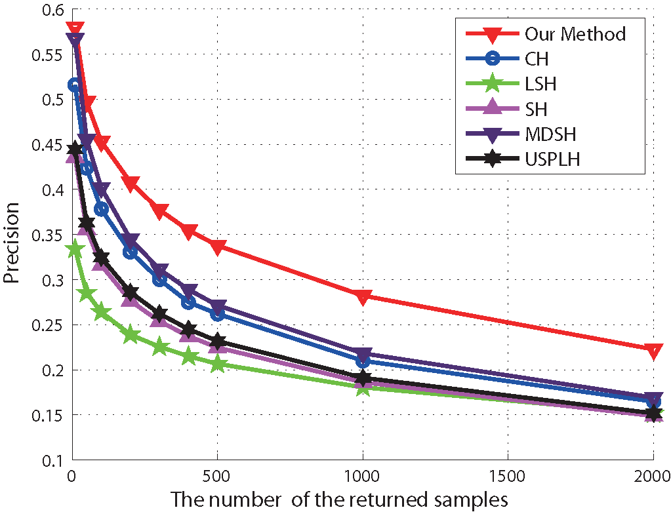
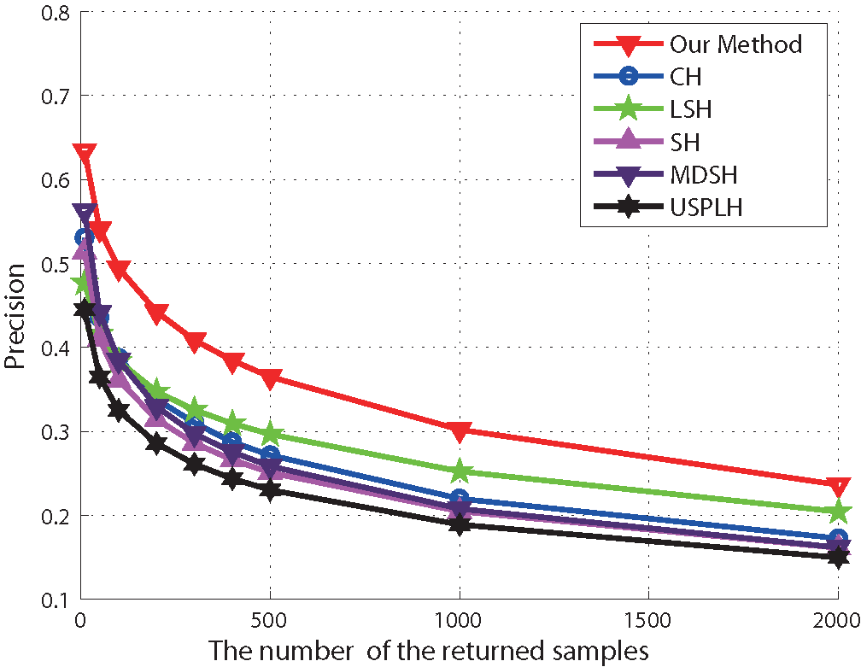
Experiments
Cifar-10 precision-the number of return samples curve
32 bits
64 bits
Notes:
Besides, We use the precision-the number of return samples curve to evaluate our method, for a fixed returned samples, the precision is also higher than the others.

Slide 50
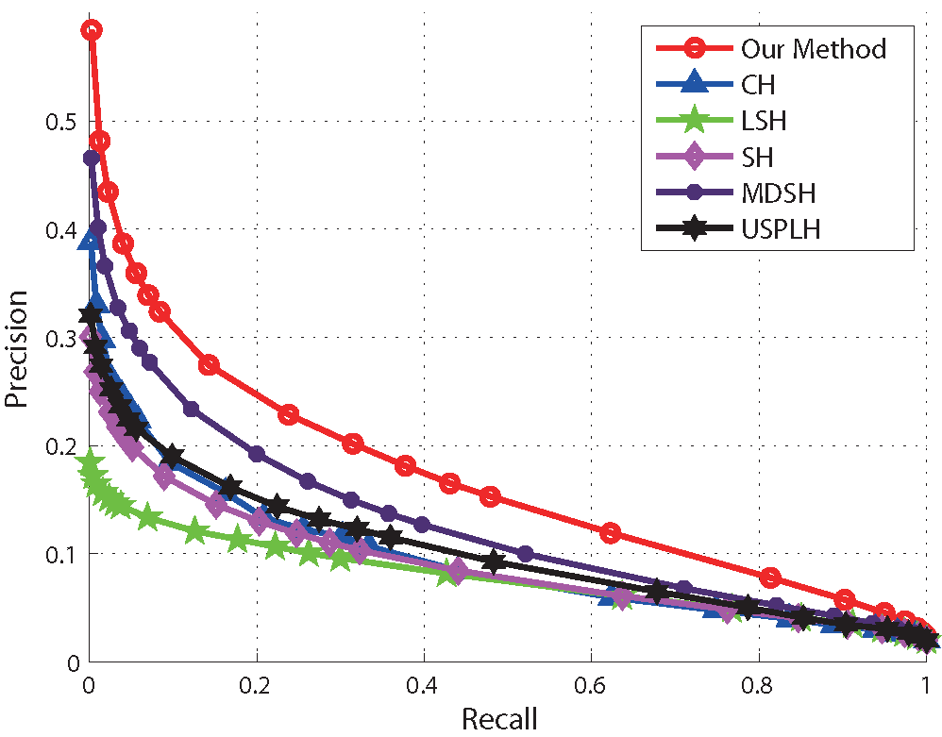
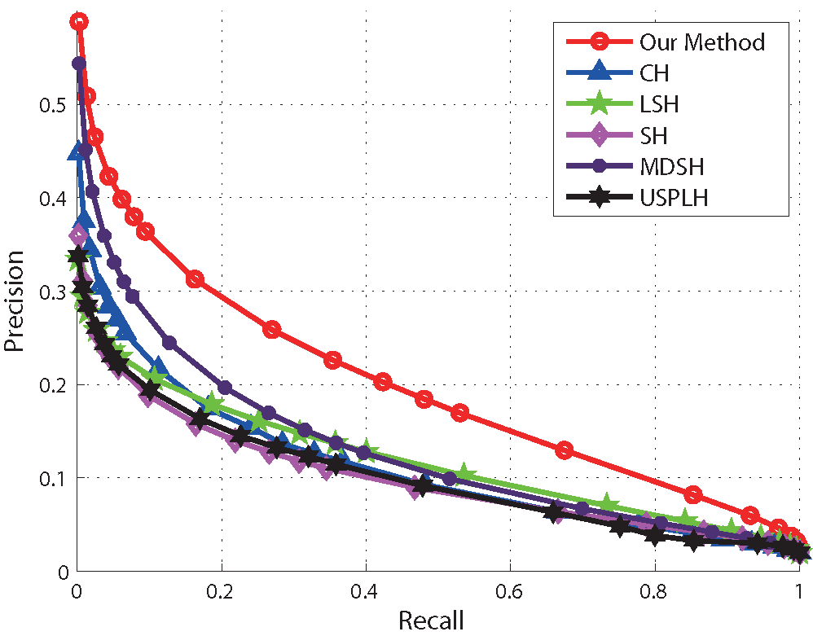
Experiments
Tiny100k precision recall curve
16 bits
32 bits
Notes:
To test the robustness of our method, we evaluate it on another benchmark dataset Tiny one hundred thousand. This is the result of the encoding length of 16 bits and 32 bits.

Slide 51
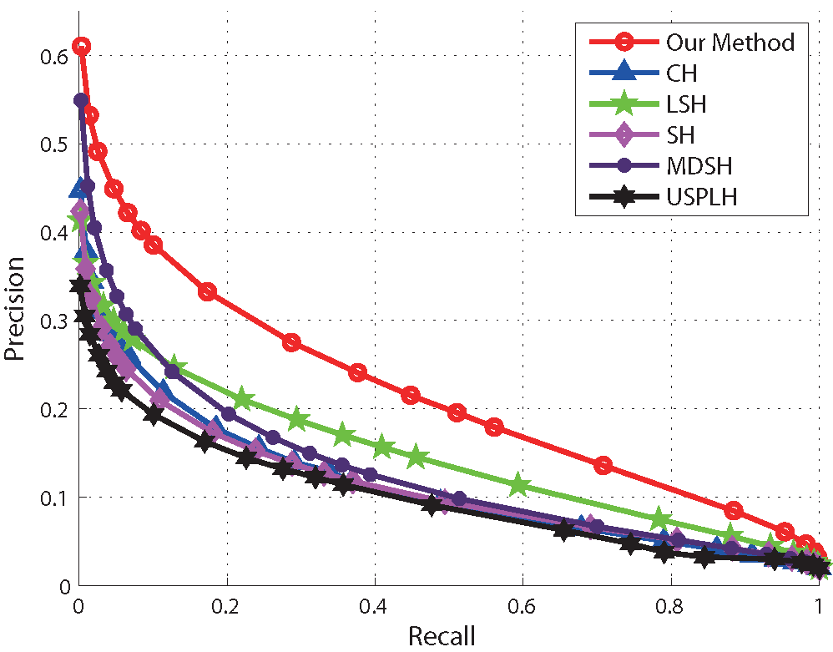
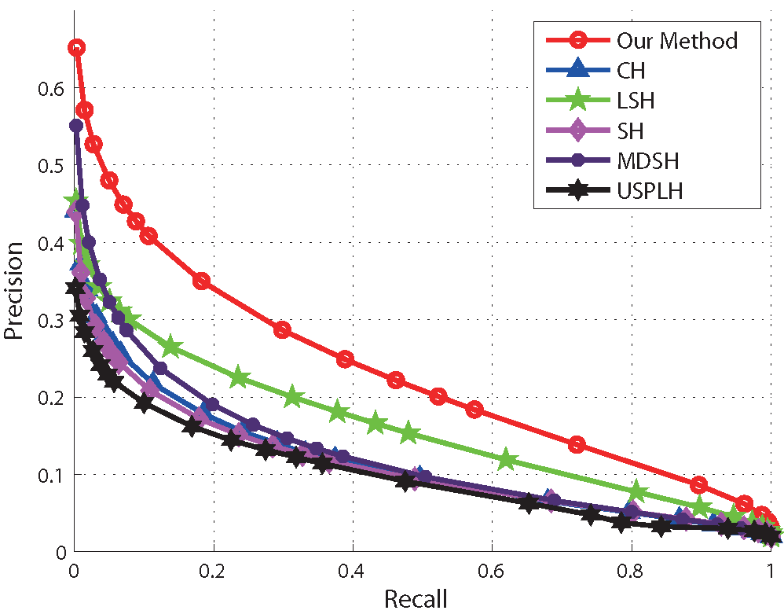
Experiments
Tiny100k precision recall curve
48 bit
64 bit
Notes:
So does 48 bits and 64 bits. as we can see, our method also outperforms the others even if the encoding length increases.

Slide 52
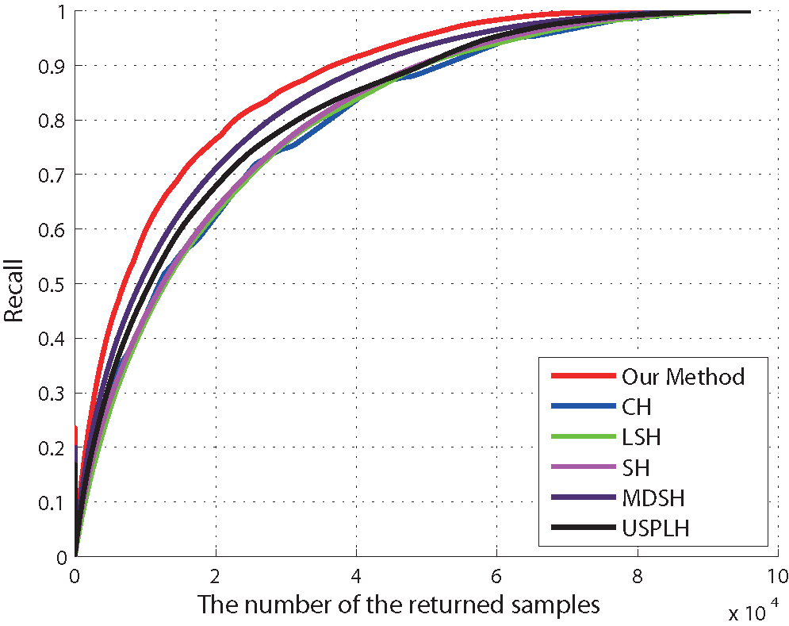
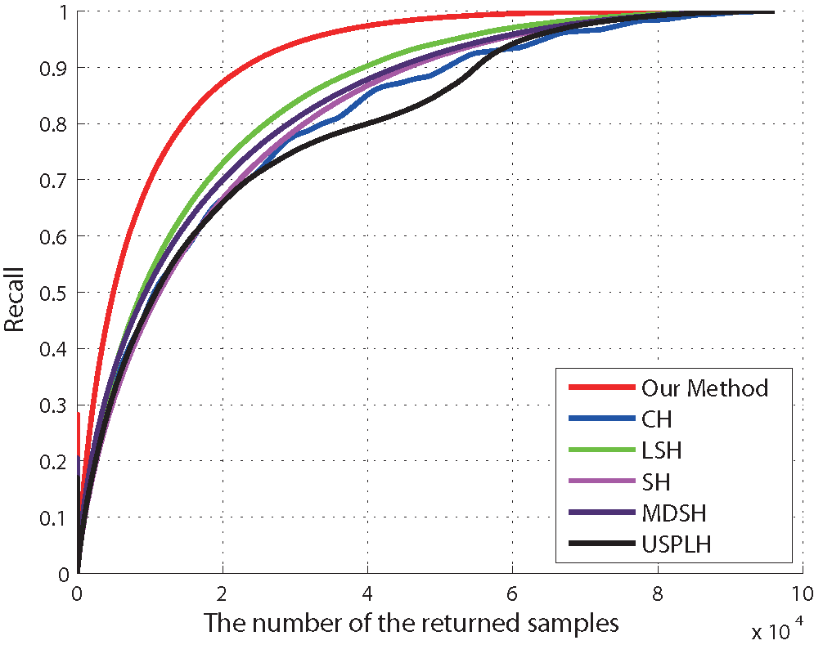
Experiments
Tiny100k recall-the number of return samples curve
16 bits
32 bits
Notes:
For the fixed number of the returned samples, the recall rate on tiny one hundred thousand is also higher than others.

Slide 53
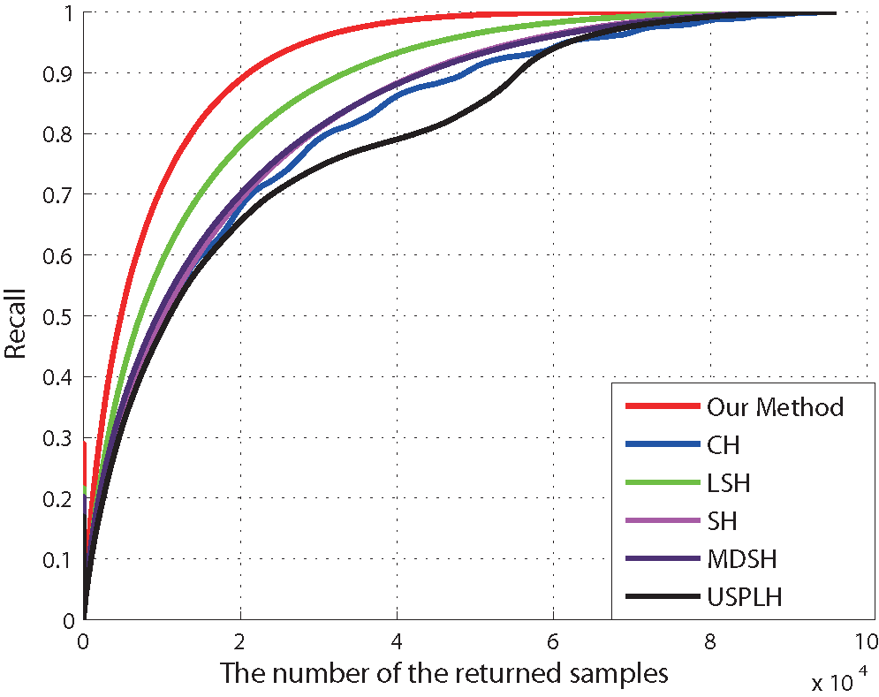
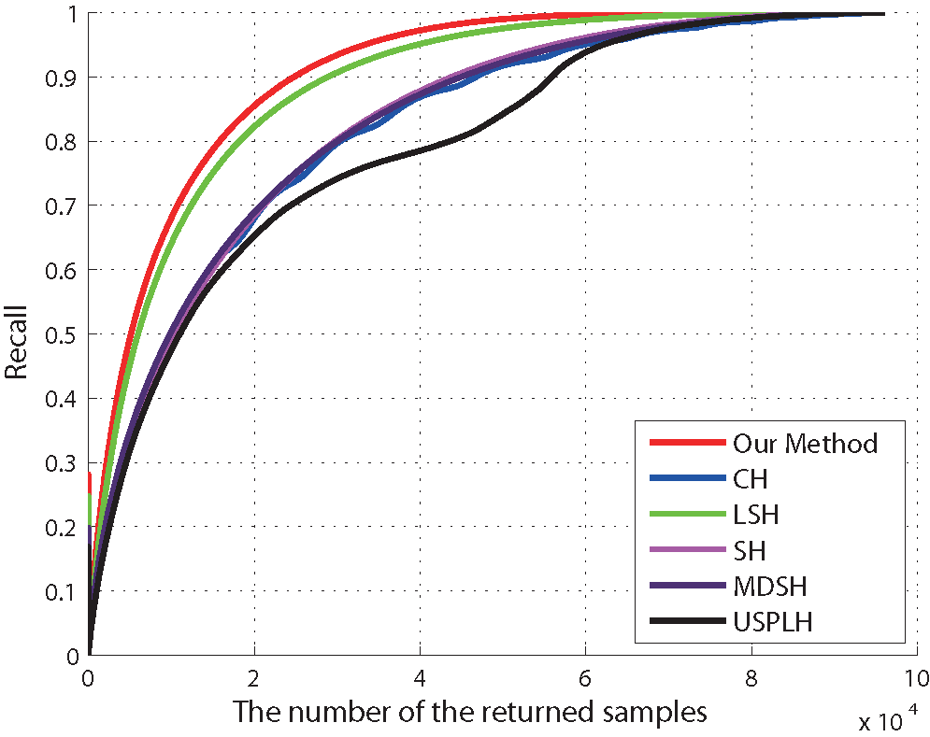
Experiments
Tiny100k recall-the number of return samples curve
48 bit
64 bit
Notes:
So does 48 bits and 64 bits

Slide 54
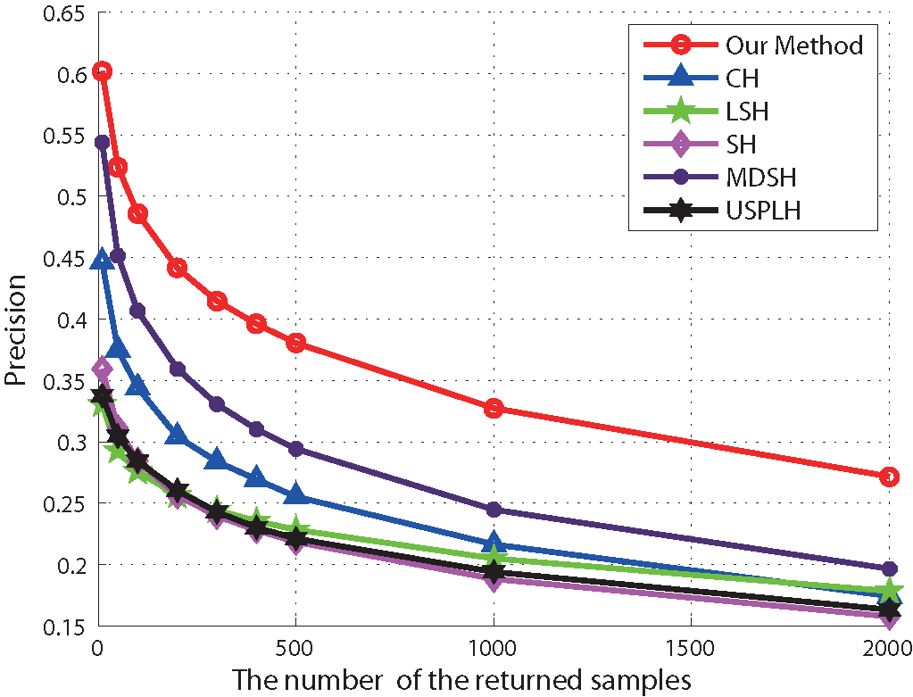
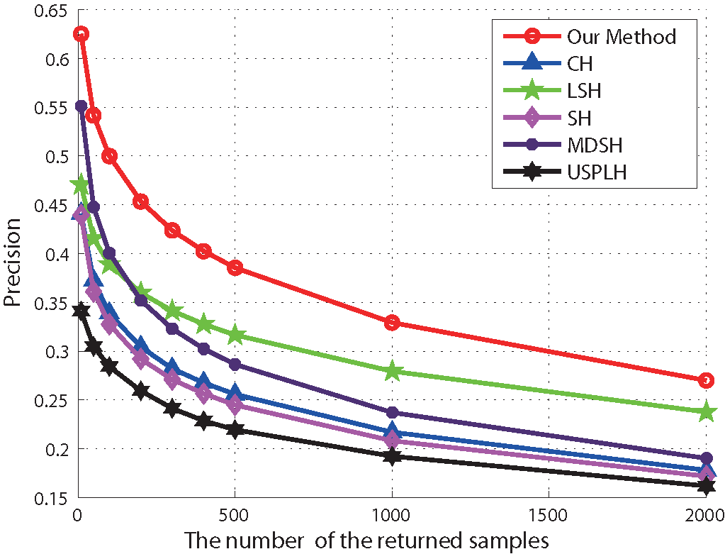
Experiments
Tiny100k precision-the number of return samples curve
32 bits
64 bits
Notes:
For the fixed number of the returned samples, the precision rate is also higher than others on tiny one hundred thousand dataset. All of the experimental result curves get higher with the encoding length increasing, and the proposed method performance is better than the competitors. It demonstrates that the proposed method to construct hash function is successful and effective.

Slide 55
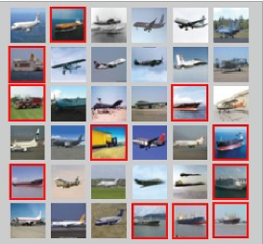
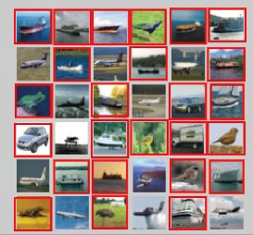
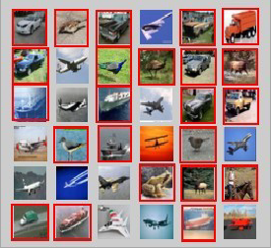
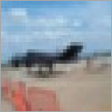
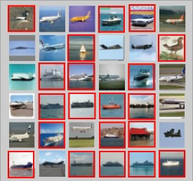
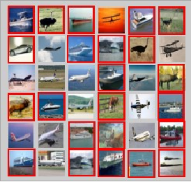
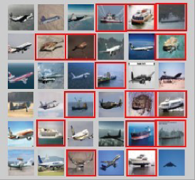
Experiments
Our method
SH
MDSH
Query image
LSH
CH
USPLH
Notes:
We also visualize the retrieved result of the proposed method and the other methods on a airplane example image. The red rectangle are the false retrieval. From the visualized result, we can see that for the query image, our method can achieve a better result than others.

Slide 56
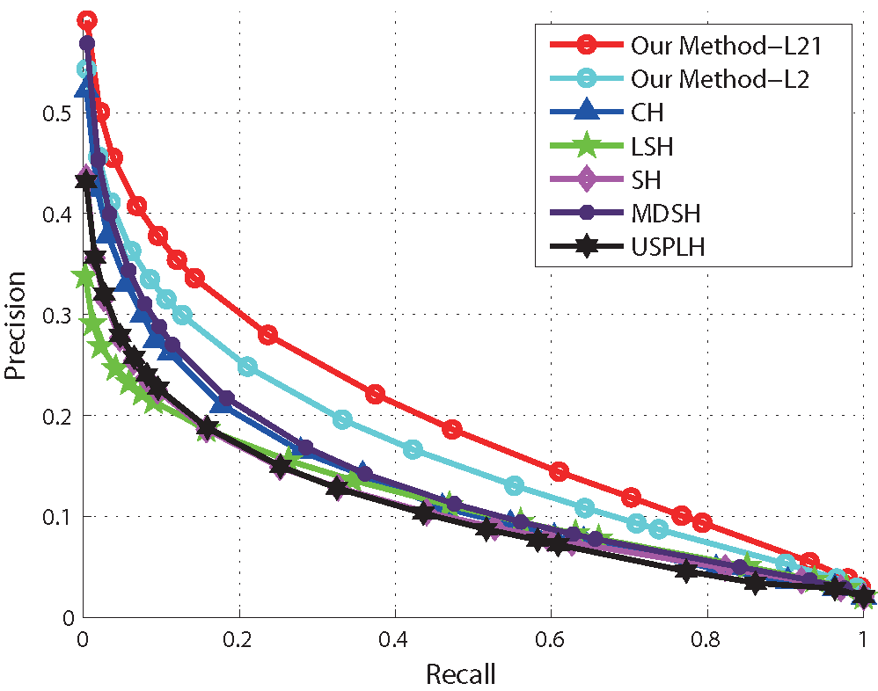
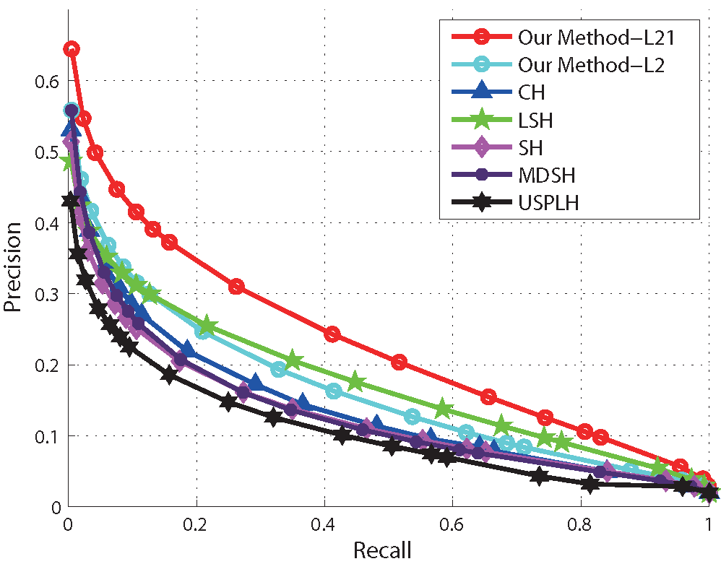
L21 Norm VS L2
Cifar-10 precision recall curve
32 bits
64 bits
Notes:
Besides, To demonstrate the sparse reconstruction effectiveness, we also do experiments compared with l-two norm constraint. The result shows the sparse reconstruction indeed contribute to improving the performance.

Slide 57
Roadmap
Overview
Method
Experiments
Summary
Notes:
Finally, we make a summary of our method.

Slide 58


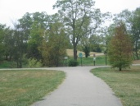
Summary
Contributions
A novel sparse reconstruction is proposed by introducing the -norm into SSP framework to preserve potential discrimination information of hash functions.
Build a balance between the maximum of empirical accuracy combined with the information theory, manifold structure and the minimum of sparse reconstruction of data points.
Future work
-1
More efficient structure models and labels information will be explored to solve ANN search problem.
-1
1
Notes:
In this paper, a novel sparse reconstruction is proposed by introducing the L2,1-norm into SSP framework to preserve potential discrimination information of hash functions. Moreover, we construct an objective function to incorporates to build a balance between the maximum of empirical accuracy combined with the information theory, manifold structure and the minimum of sparse reconstruction of data points.
The experimental results on two large-scale benchmark datasets show the benefits of our method. In future work, more efficient structure models and labels information will be explored to solve the ANN search problem.

Slide 59
Thank You
Q & A
Notes:
Thank you for your attention. If you have any question, feel free to ask me.

